Slide 1
The devil is in the details
Veronika Stengel, Sanaz Safarzaei, Ricardo Guedes

Slide 2

Welcome to our game
Genres: Horror & Thriller
Game Type: Escape Room Simulator
Experience: Atmosphere of constant suspense and mortal danger
Audience: Anyone who dares to try
“Your imagination is your greatest fear”

Slide 3
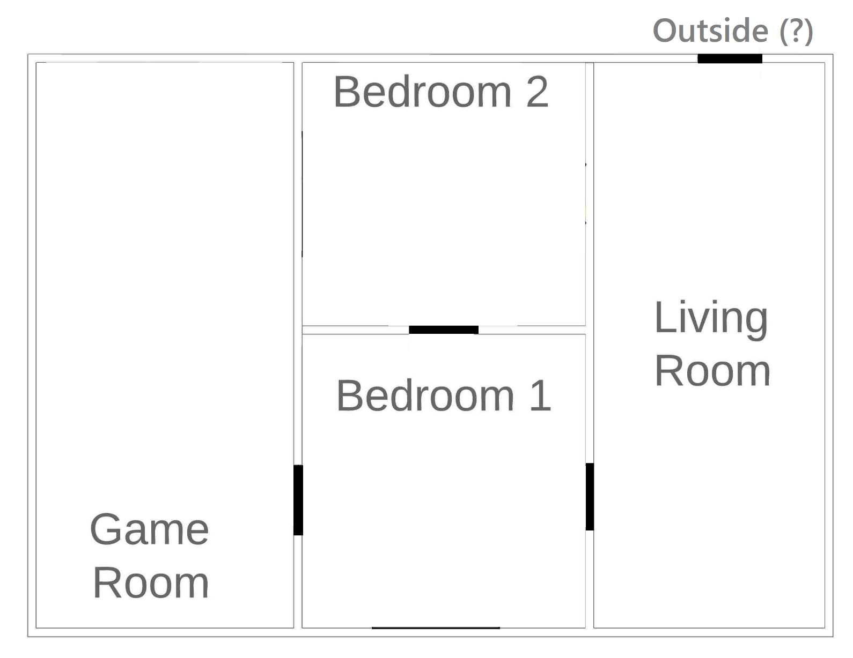
Layout of the game
5-room map
Interactable objects
One goal:
ESCAPE!

Slide 4
It’s PLAYING TIME!

Slide 5

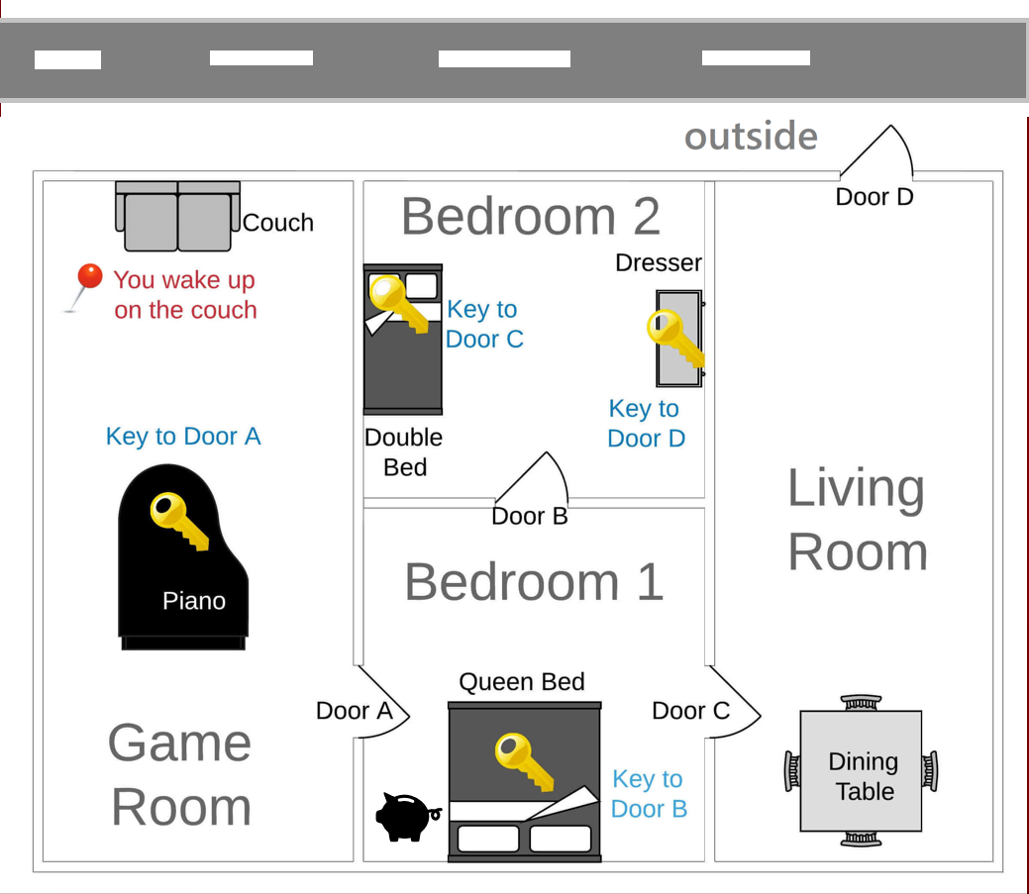
The full map

Slide 6
ADD-Ons
Text Input
Case insensitive
Text Output
Clean typos
Post credit Scenes
Extra Features
Images
Piggybank Minigame
Game Experience
A for explore
B for examine
Doors Unlocked Property
“Suspense” Text

Slide 7
Future Improvements
Multiple Languages
Images in the console
Sound Effects
Timer
Extra In-game features

Slide 8
LIbraries
PIL (for the images)
Colorama (text color)
Time (text delay)
Sys (output all in the same line)
Random (piggybank minigame)

Slide 9
THANK YOU for your attention

